Slide 1

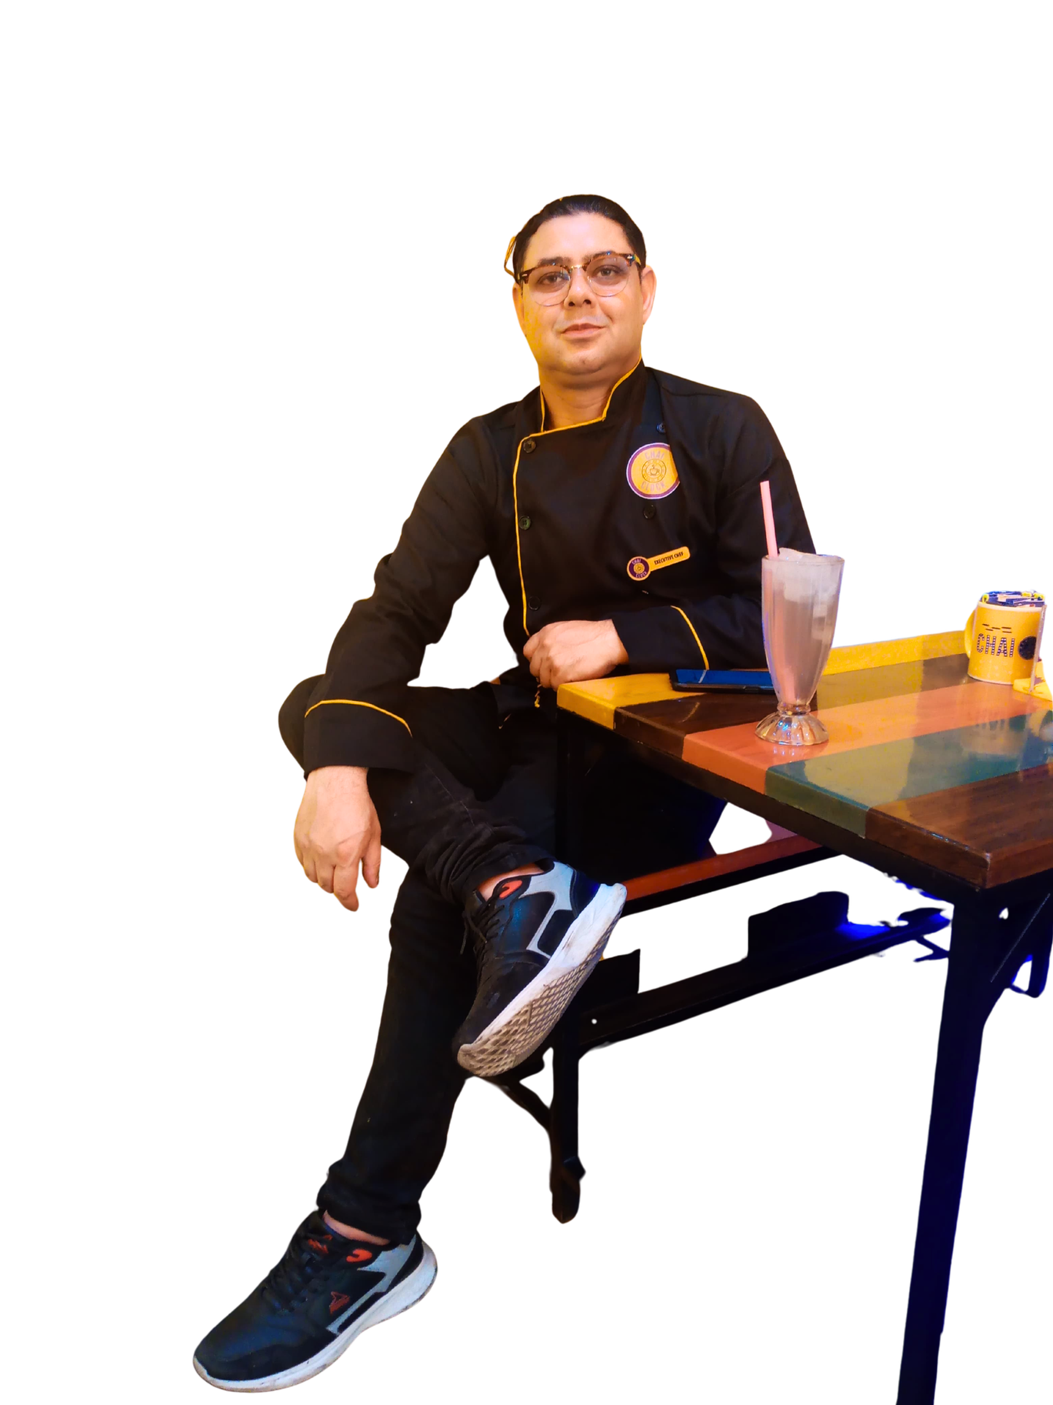
Home
About
Contact
ILYAS HUSSAIN
Executive Chef
CEO Global Foods and Hospitality Consultant
www.globalfoodsandhospitalityconsultant.com

Slide 2
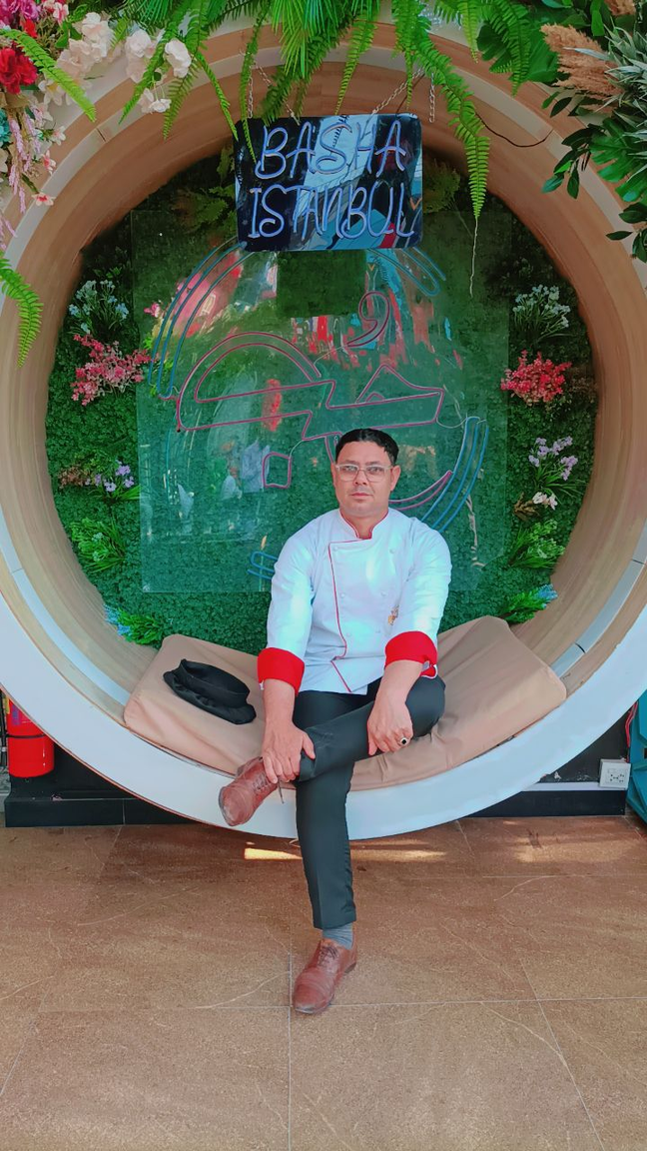
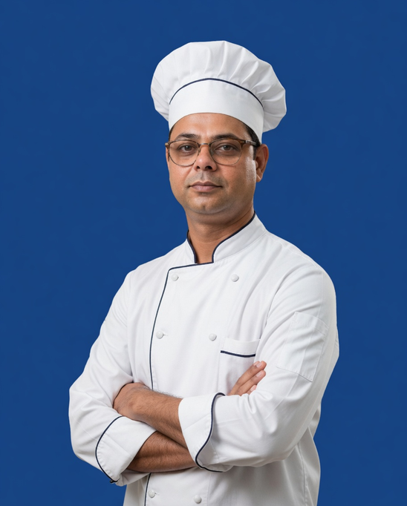
Home
About
Contact
ILYAS HUSSAIN
INTRODUCTION
I was born in a small village in Skardu, Gilgit-Baltistan, where life was simple but full of challenges. From an early age, I learned the value of hard work, patience, and determination. With limited resources but big dreams, I moved to Karachi and started my career from small local hotels, private houses, and different kitchen environments where I worked hard to learn every detail of the culinary profession.
Before reaching professional hotels, I gained experience by working in various homes and small setups, which taught me discipline, responsibility, and practical cooking skills. Later, I got the opportunity to work in Marriott and other well-known hospitality environments, where my professional journey became stronger and more refined.
Step by step, through years of dedication and passion, I built my journey from a kitchen helper to an Executive Chef and Hospitality Consultant. Today, my experience reflects not only professional growth but also the strength of perseverance and the belief that success comes to those who never stop working for it.
Learn More
www.globalfoodsandhospitalityconsultant.com

Slide 3
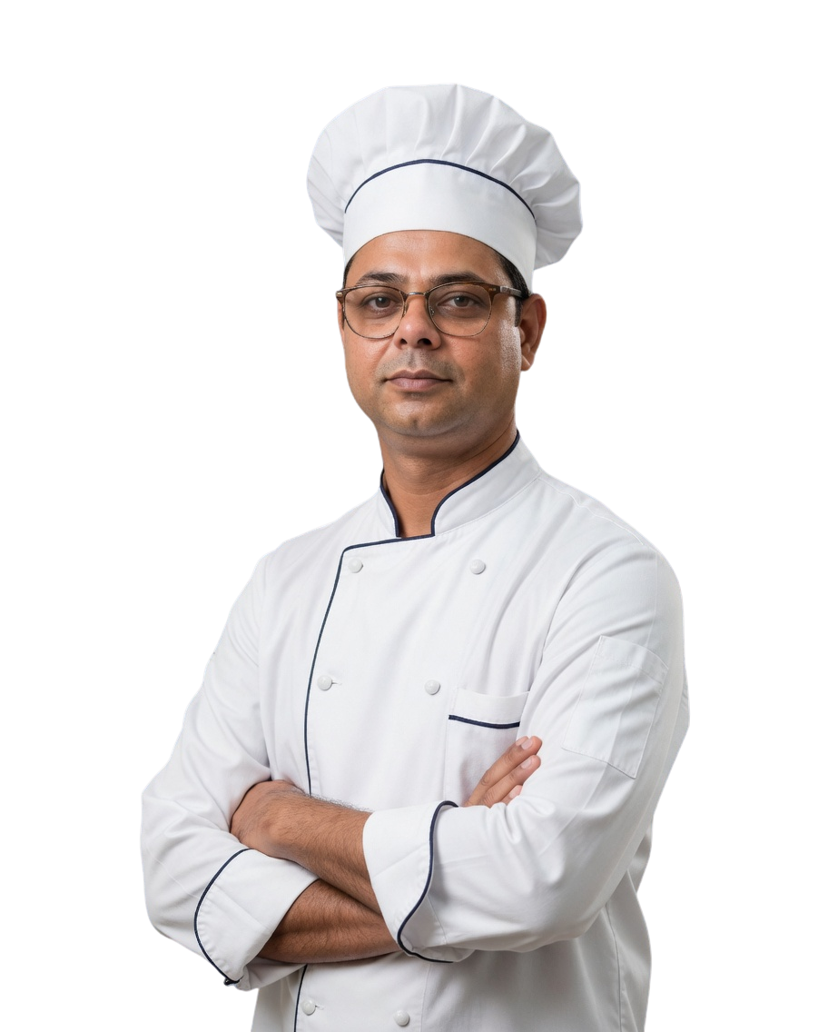
Home
About
Contact
ILYAS HUSSAIN
PROFESSIONAL PROFILE
With over 18 years of extensive culinary expertise in high-volume kitchens, luxury hospitality environments, and premium restaurant operations, I bring strong leadership in kitchen management, menu innovation, food cost control, hygiene compliance, and staff development.
I specialize in Turkish, Middle Eastern, Mediterranean, Pakistani, and Continental cuisine with proven excellence in launching successful restaurant concepts, improving operational efficiency, and building high-performing culinary teams.
My experience includes Executive Chef leadership, restaurant consultancy, kitchen setup planning, SOP development, recruitment, staff training, and complete hospitality operational support.
Learn More
www.globalfoodsandhospitalityconsultant.com

Slide 4

Home
About
Contact
ILYAS HUSSAIN
VISION
To deliver excellence in hospitality consultancy by helping restaurants, hotels, and food businesses achieve operational success, culinary distinction, and long-term profitability through professional systems, strategic planning, and world-class kitchen leadership.
www.globalfoodsandhospitalityconsultant.com

Slide 5



Home
About
Contact
ILYAS HUSSAIN
CORE EXPERTISE
  Executive Kitchen Management
  Restaurant Consultancy & Setup
  Turkish & Middle Eastern Cuisine
  Menu Engineering & Development
  Food Cost Control & Inventory Management
  SOP Development & Kitchen Systems
  Staff Recruitment & Training
  Food Safety & Hygiene Compliance
  Fine Dining Operations
  Pre-Opening Restaurant Consultancy
  Vendor & Supplier Management
  Customer Experience Enhancement
www.globalfoodsandhospitalityconsultant.com

Slide 6
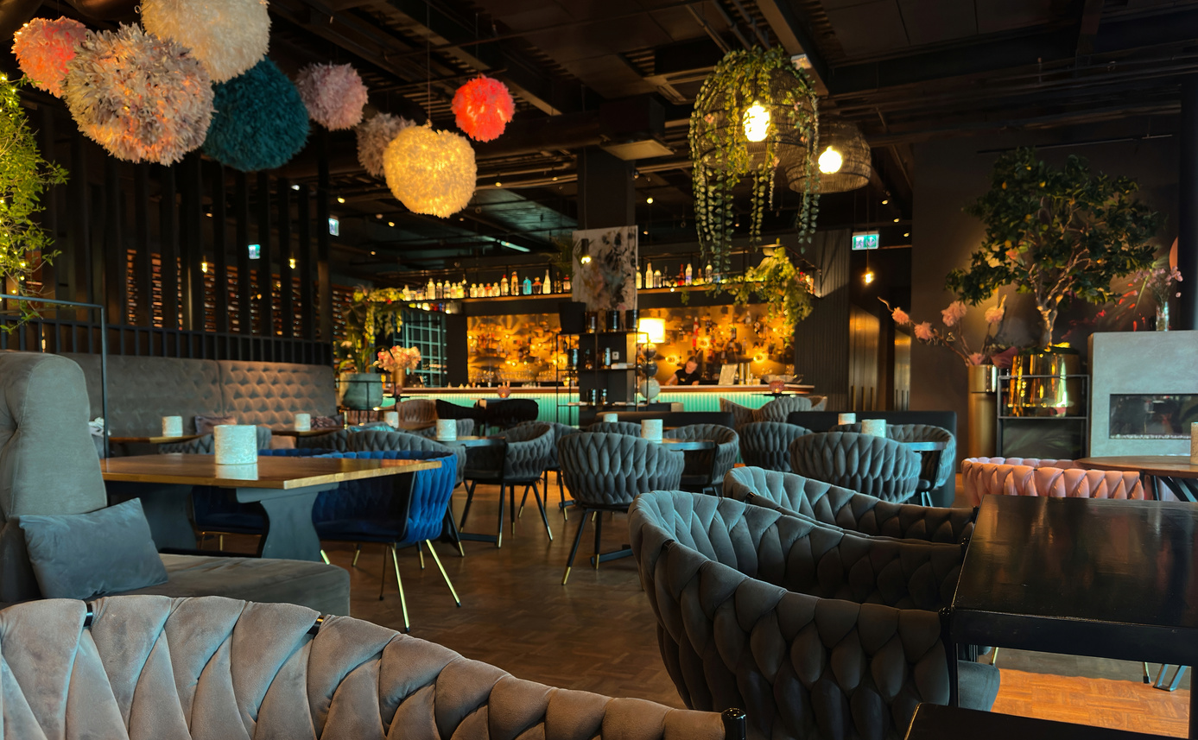

Home
About
Contact
ILYAS HUSSAIN
HOSPITALITY CONSULTANCY SERVICES
✔ Restaurant Startup Consultancy
✔ Kitchen Setup & Workflow Design
✔ Turkish & Fine Dining Restaurant Consultancy
✔ Menu Engineering & Pricing Strategy
✔ Executive Chef Services
✔ Staff Hiring & Training
✔ Food Cost Reduction Systems
✔ SOP Development
✔ Hygiene & Quality Control Systems
✔ Hotel Restaurant Operations Consultancy
www.globalfoodsandhospitalityconsultant.com

Slide 7

Home
About
Contact
ILYAS HUSSAIN
EDUCATION
2024
2013
Vocational Qualification of Cook (NAVTTC)
High School
National Vocational and Technical Training Commission
Board of Secondary Education Karachi
www.globalfoodsandhospitalityconsultant.com

Slide 8
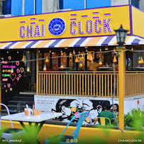
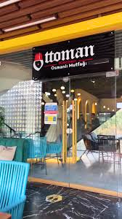

Home
About
Contact
ILYAS HUSSAIN
WORK EXPERIENCE
2024-2025
2024-2024
2022-2023
Executive Chef - Chai O’Clock Islamabad
Executive Chef – Ottoman Restaurant, Islamabad
Executive Chef – Bashah Istanbul Restaurant, Islamabad
Led complete Turkish kitchen operations, menu execution, staff supervision, and food quality management for premium dining services.
Led complete Turkish kitchen operations, menu execution, staff supervision, and food quality management for premium dining services.
Managed Turkish and Mediterranean cuisine operations with focus on menu innovation, team leadership, and kitchen profitability.
www.globalfoodsandhospitalityconsultant.com

Slide 9
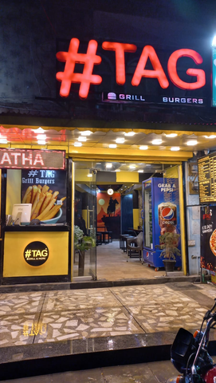
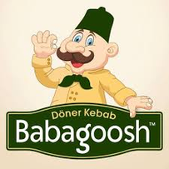
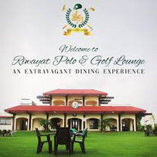
Home
About
Contact
ILYAS HUSSAIN
WORK EXPERIENCE
2021-2022
2020-2021
2018-2020
Executive Chef – #TAG Restaurant Islamabad
Executive Chef – Babagoosh Turkish Restaurant, Bahria Town Islamabad
Chef – Garrison Club Karachi
Supervised Lebanese fine dining kitchen operations, ensuring authentic taste, workflow efficiency, and staff development.
andled and managed full kitchen management including menu planning, culinary innovation, hygiene compliance, and staff training.
Handled full kitchen management including menu planning, culinary innovation, hygiene compliance, and staff training.
www.globalfoodsandhospitalityconsultant.com

Slide 10
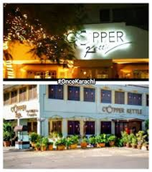
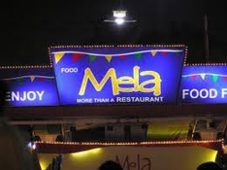
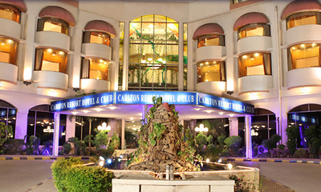
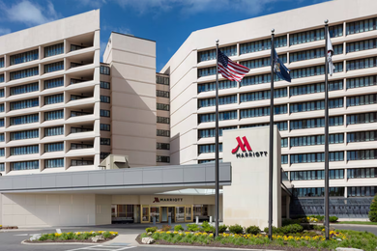
Home
About
Contact
ILYAS HUSSAIN
WORK EXPERIENCE
2008-2018
Worked across hotels, clubs, and restaurants in multiple culinary roles, building strong expertise from kitchen helper to senior chef leadership.
  All-Rounder Cook – Copper Kettle Restaurant Karachi
  Chef – Mela Restaurant Karachi
  Kitchen Helper – Carlton Hotel Karachi
  Trainee – Marriott Hotel Karachi
www.globalfoodsandhospitalityconsultant.com

Slide 11
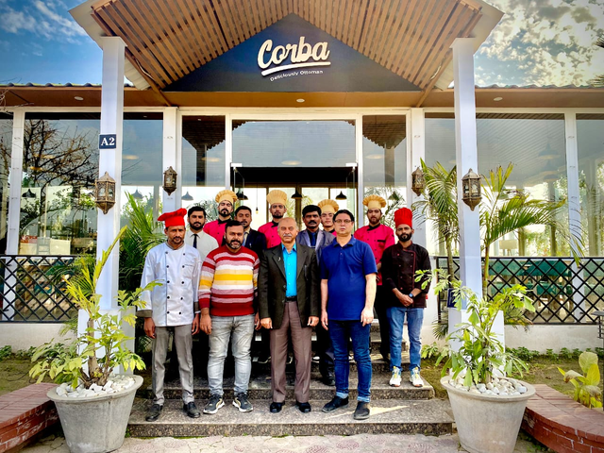

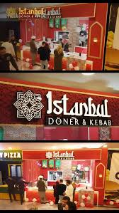
Home
About
Contact
ILYAS HUSSAIN
PROJECT PORTFOLIO
www.globalfoodsandhospitalityconsultant.com

Slide 12
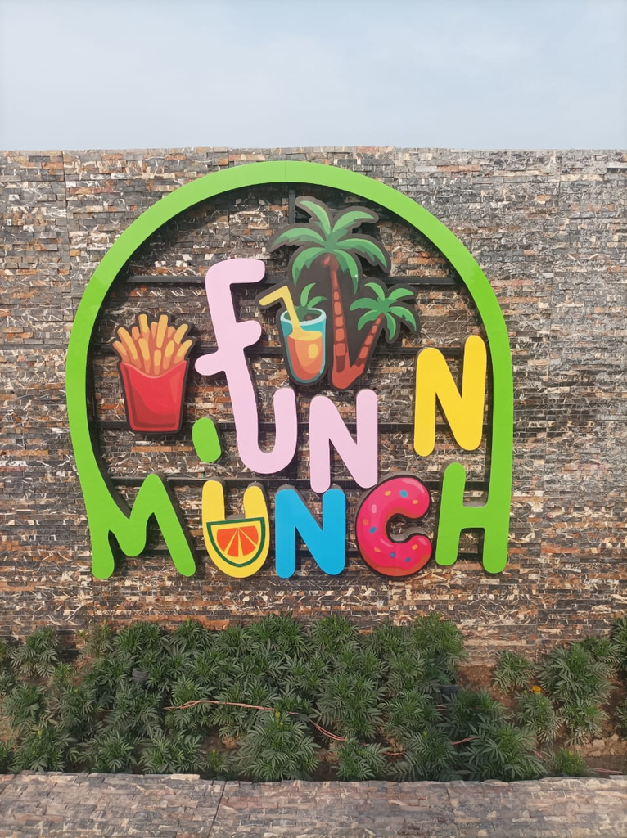
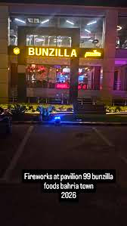
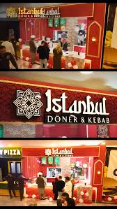
Home
About
Contact
ILYAS HUSSAIN
MY LATEST PROJECTS
  Fun N Munch – DHA Multan
Restaurant consultancy with focus on service flow, menu execution, and staff management.
  Bunzilla Restaurant – Bahria
Hospitality consultancy including kitchen systems, staffing, and operational support.
  Istanbul Doner Kebab – Wah Cantt
Restaurant planning, menu engineering, workflow design, and kitchen optimization.
www.globalfoodsandhospitalityconsultant.com

Slide 13

Home
About
Contact
ILYAS HUSSAIN
PAST PROJECTS
  Ottoman Restaurant - Islamabad
Complete Turkish restaurant operational consultancy and executive kitchen setup.
  Basha Istanbul - Islamabad
Full restaurant consultancy including kitchen operations, menu planning, staffing, and SOP development.
www.globalfoodsandhospitalityconsultant.com

Slide 14
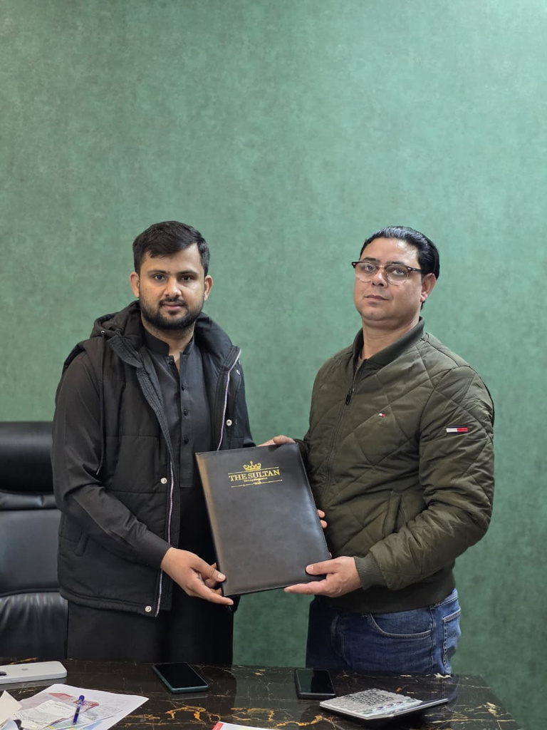

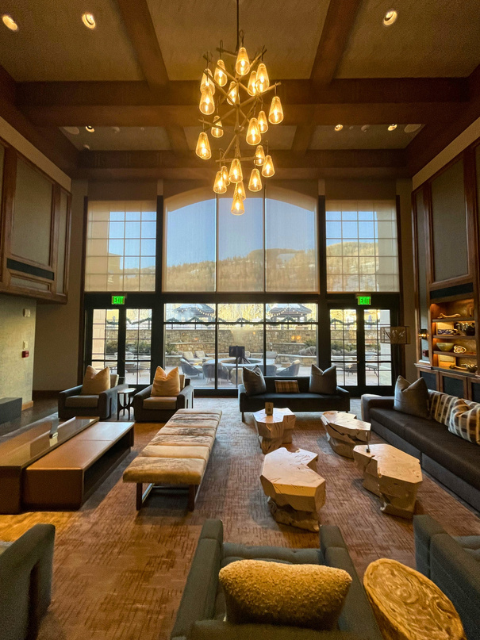
Home
About
Contact
ILYAS HUSSAIN
ONGOING PROJECTS
  Methmat Sultan Steak House – New Blue Area
Fine dining steakhouse consultancy with complete restaurant operational planning.
  Metthmat Sultan – Bahria F-7
Kitchen design consultancy, menu planning, and premium hospitality systems setup.
  The Sultan Hotel – Islamabad
Hotel food operations consultancy including restaurant planning, kitchen systems, and hospitality execution.
www.globalfoodsandhospitalityconsultant.com

Slide 15
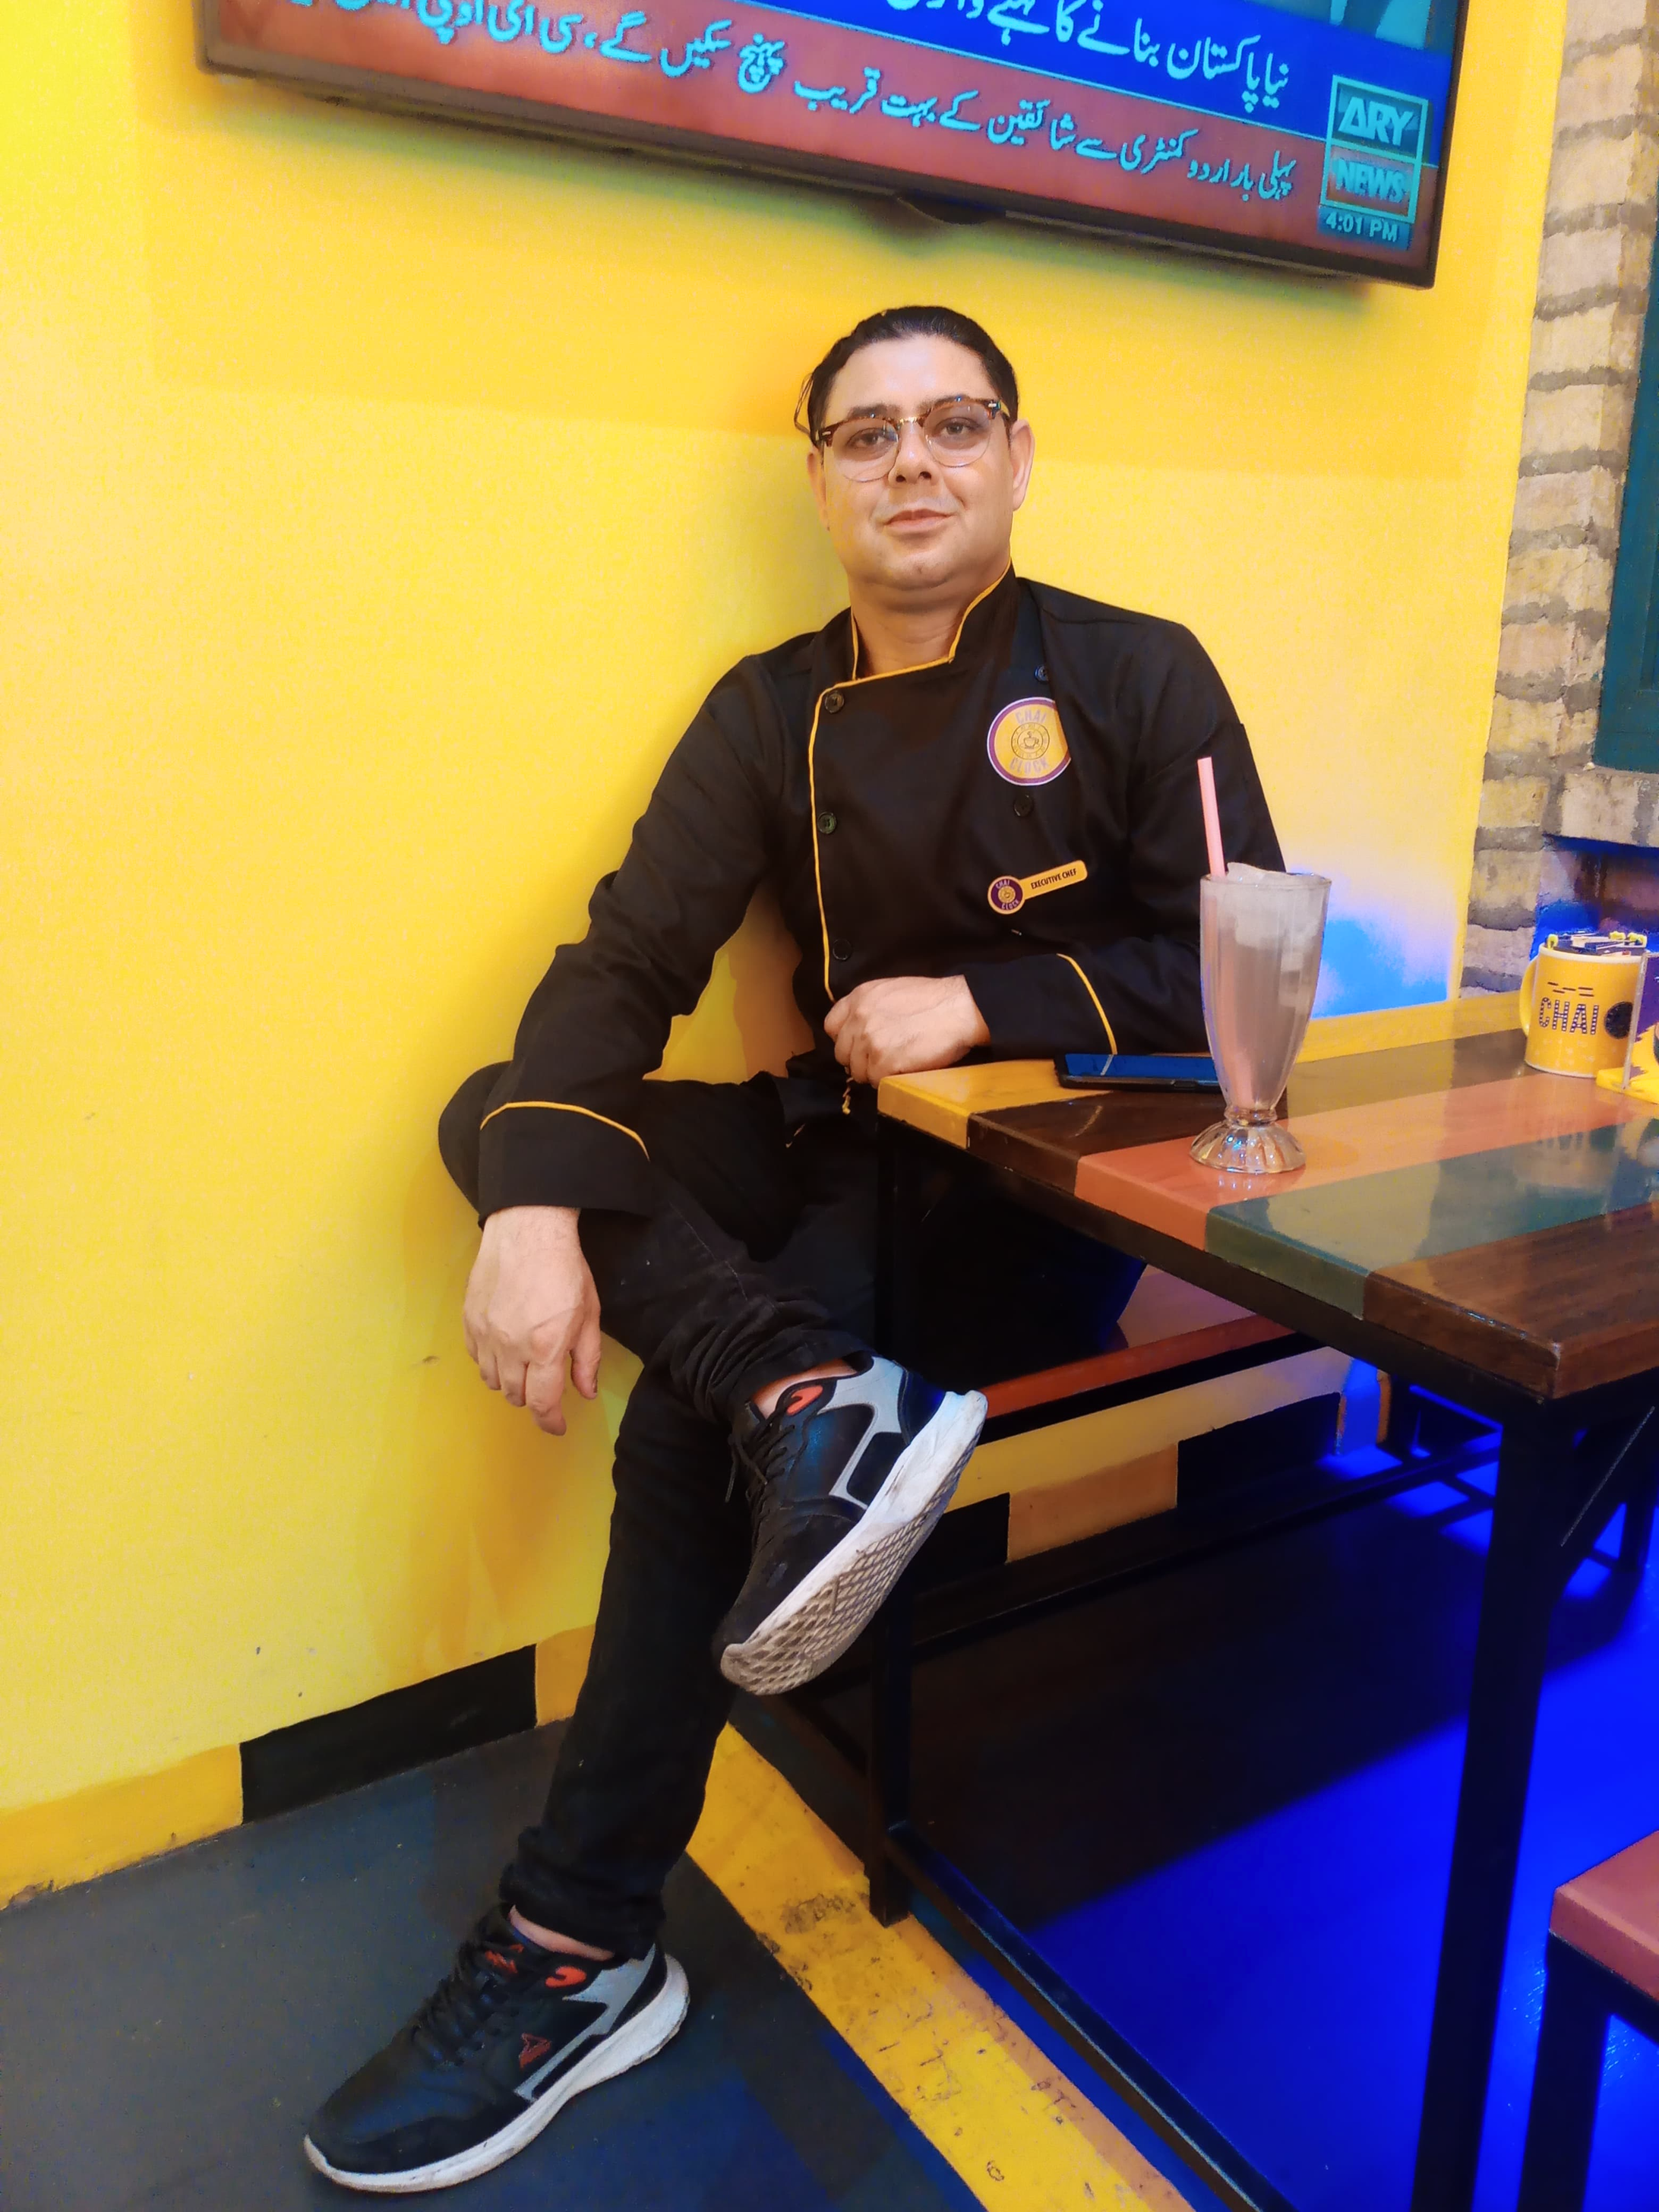
Home
About
Contact
ILYAS HUSSAIN
GET IN TOUCH
Email
Social Media
hilyas532@gmail.com
@IlyasHussain
Website
Phone Number
www.globalfoodsandhospitalityconsultant.com
+92 3445316782
www.globalfoodsandhospitalityconsultant.com

Slide 16
Home
About
Contact
ILYAS HUSSAIN
THANK YOU
For Your Attention
www.globalfoodsandhospitalityconsultant.com

